Slide 1



Retail Business Intelligence & Sales Analytics Platform
View in Power BI

Slide 2
Retail Business Intelligence & Sales Analytics Platform
Objective:-
Develop an end-to-end Business Intelligence solution to analyse retail sales performance, customer behaviour, product profitability, and regional trends using SQL, Python, and Power BI.
Tech Stack:-
SQL
Python
Pandas
NumPy
Power BI
DAX
Excel

Slide 3
Retail Business Intelligence & Sales Analytics Platform
Dataset Information:-
Include:-
Total Records: 100,000
Time Period: 2019–2023
Customers: 100,000
Products: 100,000
Regions: 4
States: 10
Dataset Fields
Order ID
Customer ID
Product Name
Sales
Profit
Quantity
Discount
Region
State
Segment
Category

Slide 4
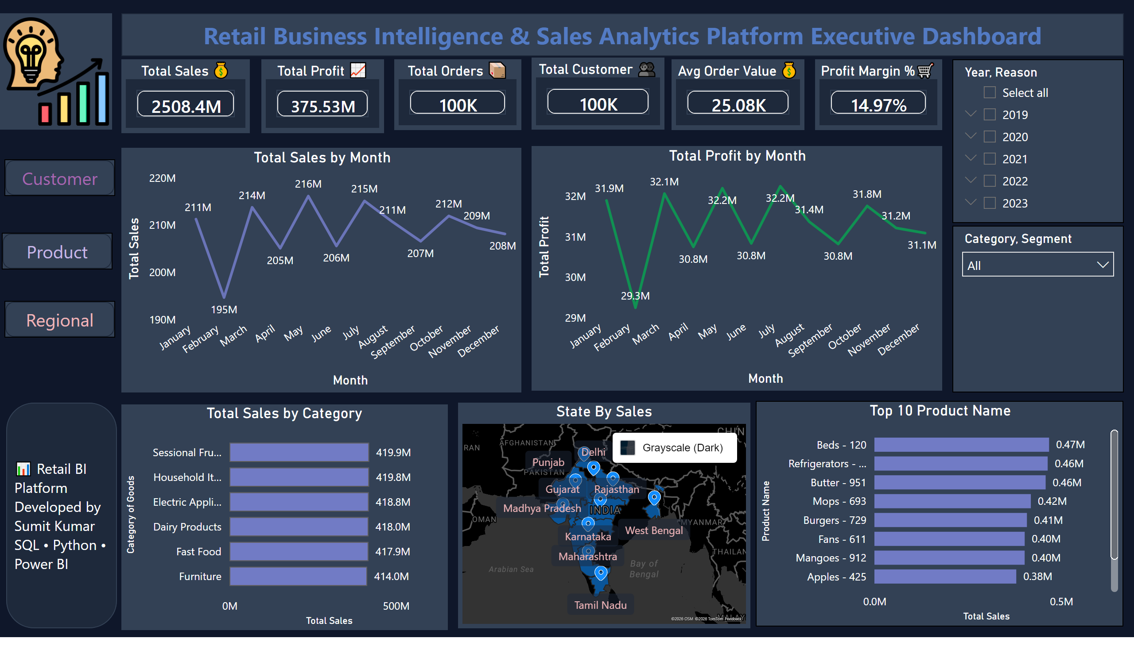
Executive Dashboard
Notes:
Total Sales 💰
No alt text provided
Total Orders 📦
No alt text provided
Total Customer 👥
No alt text provided
Avg Order Value 💰
No alt text provided
Profit Margin %🛒
No alt text provided
Total Profit 📈
No alt text provided
lineChart
No alt text provided
lineChart
No alt text provided
Total Sales by Category
No alt text provided
State By Sales
No alt text provided
Top 10 Product Name
No alt text provided
slicer
No alt text provided
slicer
No alt text provided
textbox
No alt text provided
shape
No alt text provided
image
No alt text provided
shape
No alt text provided
shape
No alt text provided
shape
No alt text provided

Slide 5
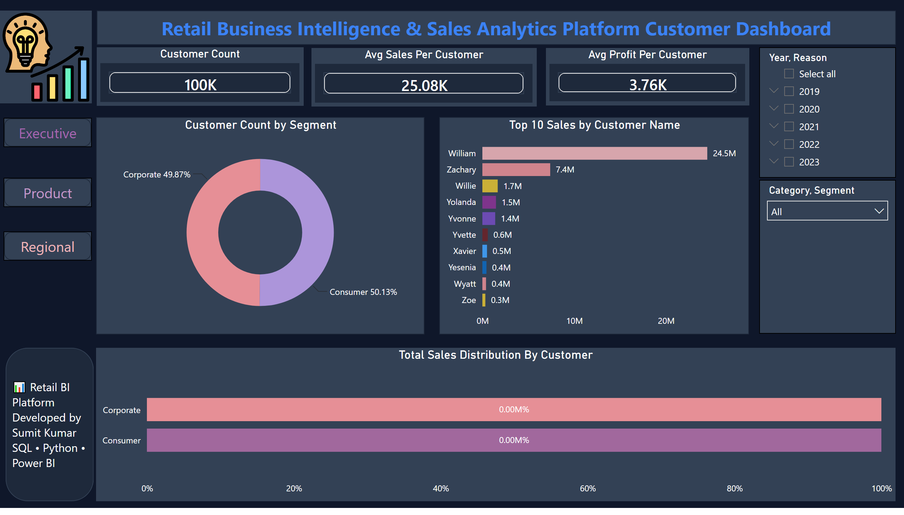
Customer Dashboard
Notes:
Customer Count
No alt text provided
Avg Profit Per Customer
No alt text provided
Avg Sales Per Customer
No alt text provided
slicer
No alt text provided
slicer
No alt text provided
textbox
No alt text provided
image
No alt text provided
shape
No alt text provided
shape
No alt text provided
shape
No alt text provided
shape
No alt text provided
donutChart
No alt text provided
Top 10 Sales by Customer Name
No alt text provided
Total Sales Distribution By Customer
No alt text provided

Slide 6
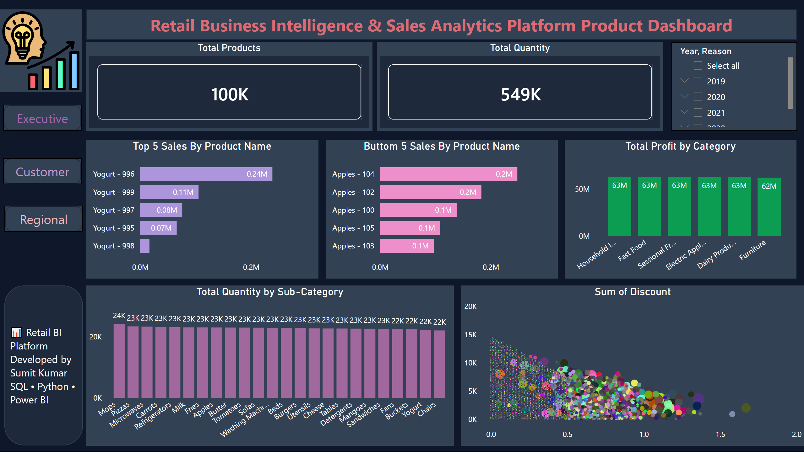
Product Dashboard
Notes:
Total Products
No alt text provided
Total Quantity
No alt text provided
slicer
No alt text provided
textbox
No alt text provided
shape
No alt text provided
image
No alt text provided
shape
No alt text provided
shape
No alt text provided
shape
No alt text provided
Top 5 Sales By Product Name
No alt text provided
Buttom 5 Sales By Product Name
No alt text provided
Total Profit by Category
No alt text provided
Total Quantity by Sub-Category
No alt text provided
Sum of Discount
No alt text provided

Slide 7
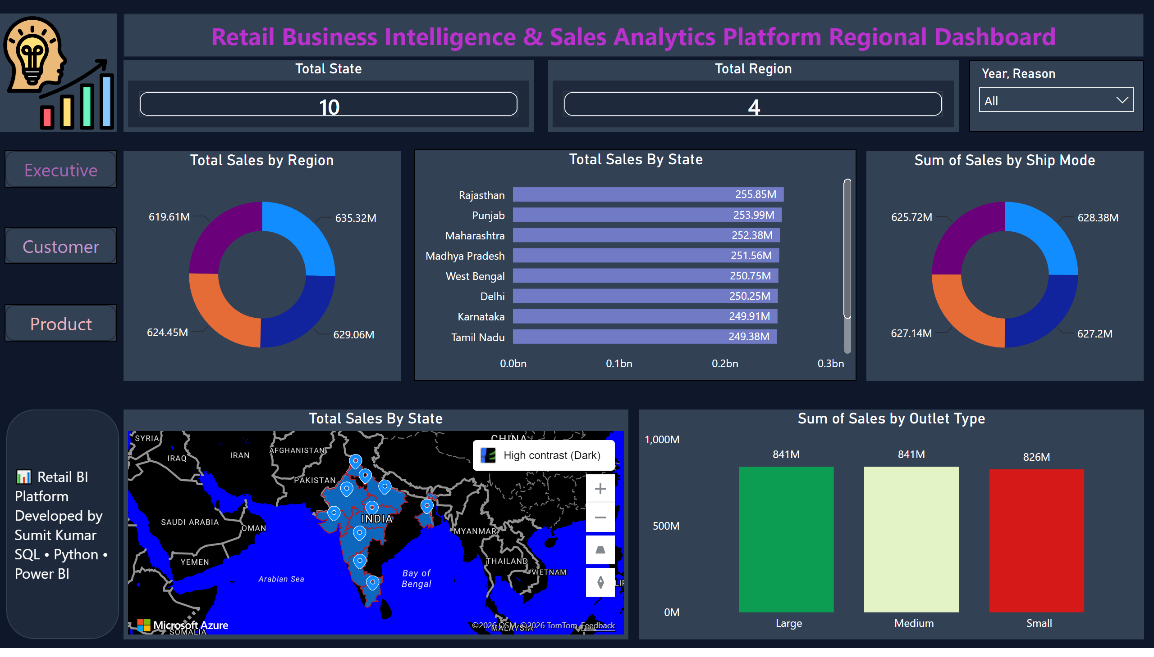
Regional Dashboard
Notes:
Total State
No alt text provided
Total Region
No alt text provided
Total Sales By State
No alt text provided
Total Sales By State
No alt text provided
slicer
No alt text provided
textbox
No alt text provided
shape
No alt text provided
image
No alt text provided
shape
No alt text provided
shape
No alt text provided
shape
No alt text provided
Total Sales by Region
No alt text provided
columnChart
No alt text provided
donutChart
No alt text provided

